Slide 1

FLIGHT FARE PREDICTION
-USING MACHINE LEARNING

Slide 2
Team Members
Student Id | Student Name | Email Address | Role
11664532 | Achyuth Reddy Kanumanthu | AchyuthReddyKanumanthu@my.unt.edu | ML Developer and Deployment
11657224 | VVSS Vyjayanthi Mamidipalli | VVSSVyjayanthiMamidipalli@my.unt.edu | Data Analyst
11703470 | Kosuri Vandana | VandanaKosuri@my.unt.edu | Data Engineer
11710243 | Yuvaraj Sriramoju | YuvarajSriramoju@my.unt.edu | ML Developer
11655488 | Vamshi Kalyan Yerramilli | VamshiKalyanYerramilli@my.unt.edu | Documentation

Slide 3
THE AGENDA OF THE PROJECT
This study involves a comprehensive analysis of a flight booking dataset acquired from the esteemed website named 'Ease My Trip'. Our research methodology integrates statistical hypothesis tests and predictive modeling techniques which includes Linear Regression, Support Vector Regression (SVR), and Random Forest Regression.
The primary objective is to extract valuable insights into the relationship between variables and predictive accuracy. Notably, this analysis offers benefits to travelers by refining pricing strategies and improving the booking experience.
Moreover, it furnishes invaluable knowledge to the aviation industry. Essentially, this project acts as a conduit between data-driven insights and practical advantages, fostering a mutually beneficial scenario for all stakeholders within the realm of flight bookings.

Slide 4
Project Scope
In our detailed study, we thoroughly examined a dataset from "Ease My Trip" to understand flight booking patterns. Using statistical tests and predictive models like Linear Regression, SVR, and Random Forest, we aimed to provide valuable insights for travelers and the aviation industry.
The project covered data collection, analysis, model development, and real-time predictions. We deployed the regression model on AWS and Flask(API) for user-friendly flight fare predictions. The tools included Python, Kaggle Data, Pycharm, JupyterLab, Google Colab, NumPy, Pandas, Matplotlib, Scikit-learn, and Git.
Our goal is to bridge the gap between data analysis and practical benefits in the field. Our team contributed to data exploration, preprocessing, regression modeling, parameter tuning, and deploying the final model to the AWS cloud.

Slide 5
Software and Hardware Requirements
Software
Hardware
Programming Language | Python 3
Deployment Platform | AWS, Flask(API)
Dataset | Kaggle Data
IDE | Pycharm, JupyterLab, Google Colab
Python Libraries | NumPy, Pandas, Matlplotlib, Scikit-learn
Version Control | Git
Operating system | Windows 11
Window processor | 32- or 64-bit
Ram | 4 or 8 GB
Processor | Intel core i5

Slide 6
Phase 1: Data Collection and Pre-Processing
Identifying and handling missing values in the dataset, ensuring that critical information for features like flight details, timings, and pricing is complete.
Addressing any anomalies or outliers in the dataset related to flight prices or other relevant attributes.
Converting categorical variables into numerical representations. For instance, encode airline names, source and destination cities, and class types to numeric values for compatibility with regression models.

Slide 7
Phase 1: Data Collection and Pre-Processing
Normalizing numerical features such as flight duration, days left for booking, and any other relevant attributes to a consistent scale. This ensures that all features contribute equally to the model training.
Dividing the dataset into training and testing sets to assess the model's performance accurately. This partition allows you to train the model on one subset and validate its predictions on another, providing insights into generalization.
For features like flight stops, handle categorical variables appropriately. We convert them into numeric representations or employ one-hot encoding to facilitate the model's understanding

Slide 8
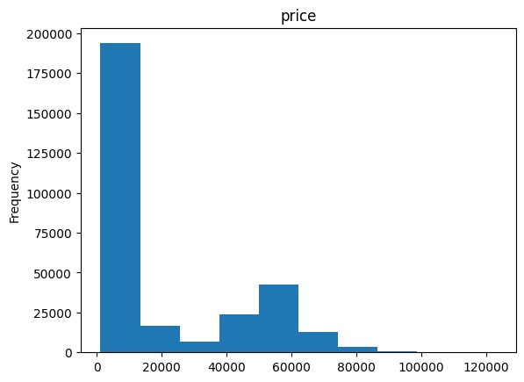
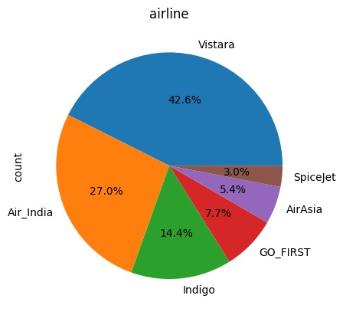
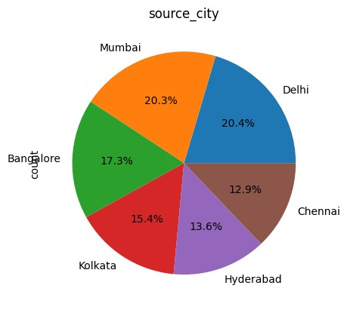
Phase – 2 EXPLORATORY DATA ANALYSIS
Analyzed The Dataset To Understand Its Characteristics
Performed exploratory data analysis to gain insights into feature distributions, correlations, and potential relationships with the target variable (flight prices). Below are few Examples.

Slide 9
Phase – 3 : Model Development
We chose regression model for forecasting flight prices.
Assess the model's precision by testing it with actual data to evaluate its performance.
We are using different machine learning techniques like Linear Regression, Support Vector Regression (SVR), Random Forest Regression, Decision tree regression, KNN and Ensemble models (XG Boost).
We have used Hyper Parameter tuning techniques to get Best parameters.
Each of these models has its architecture, with varying depths and complexities.

Slide 10
Phase – 4 : Model Tuning and Validation
Model | Train Accuracy | Test Accuracy | Best Parameters
Linear Model | 91.0 | 91 | NA
Decision Tree Regressor | 96.2 | 96.2 | {'max_depth': 5, 'min_samples_split': 2, 'min_samples_leaf': 1}
SVR | 92.5 | 84.1 | {'C': 100, 'gamma': 'scale', 'kernel': 'rbf'}
RandomForestRegressor | 84.1 | 67.5 | {'max_depth': None, 'min_samples_leaf': 1, 'min_samples_split': 2, 'n_estimators': 300}
KNN Regressor | 78.9 | 59.6 | {‘n_neighbors’=5,’ algorithm’:’kd_tree’}
XG Boost | 86.3 | 78.9 |  | {‘booster’=’gblinear’,’ lambda’=’ reg_lambda’,’ alpha’=’ reg_alpha’,’n_estimators’ = 10}
Perform Hyper Parameter tuning to get the best parameters which gives the best accuracy on different models.
Based up on the accuracy after applying parameter tuning, we finalized Decision Tree Regression as our final model.

Slide 11

Phase 5: Model Selection and Deployment
After choosing the most accurate model on the validation set, prepare it for deployment.
Deploy the selected model on a cloud platform :Amazon AWS

Slide 12
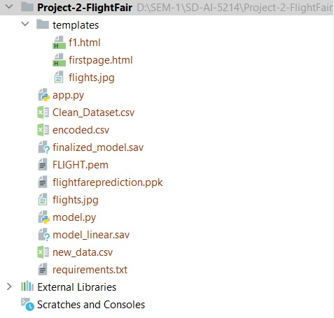
Project Deployment Architecture
app.py is the main file that start’s the application
model.py where we load trained model and predict the price.
finalized_model.sav is saved model with the weights.

Slide 13
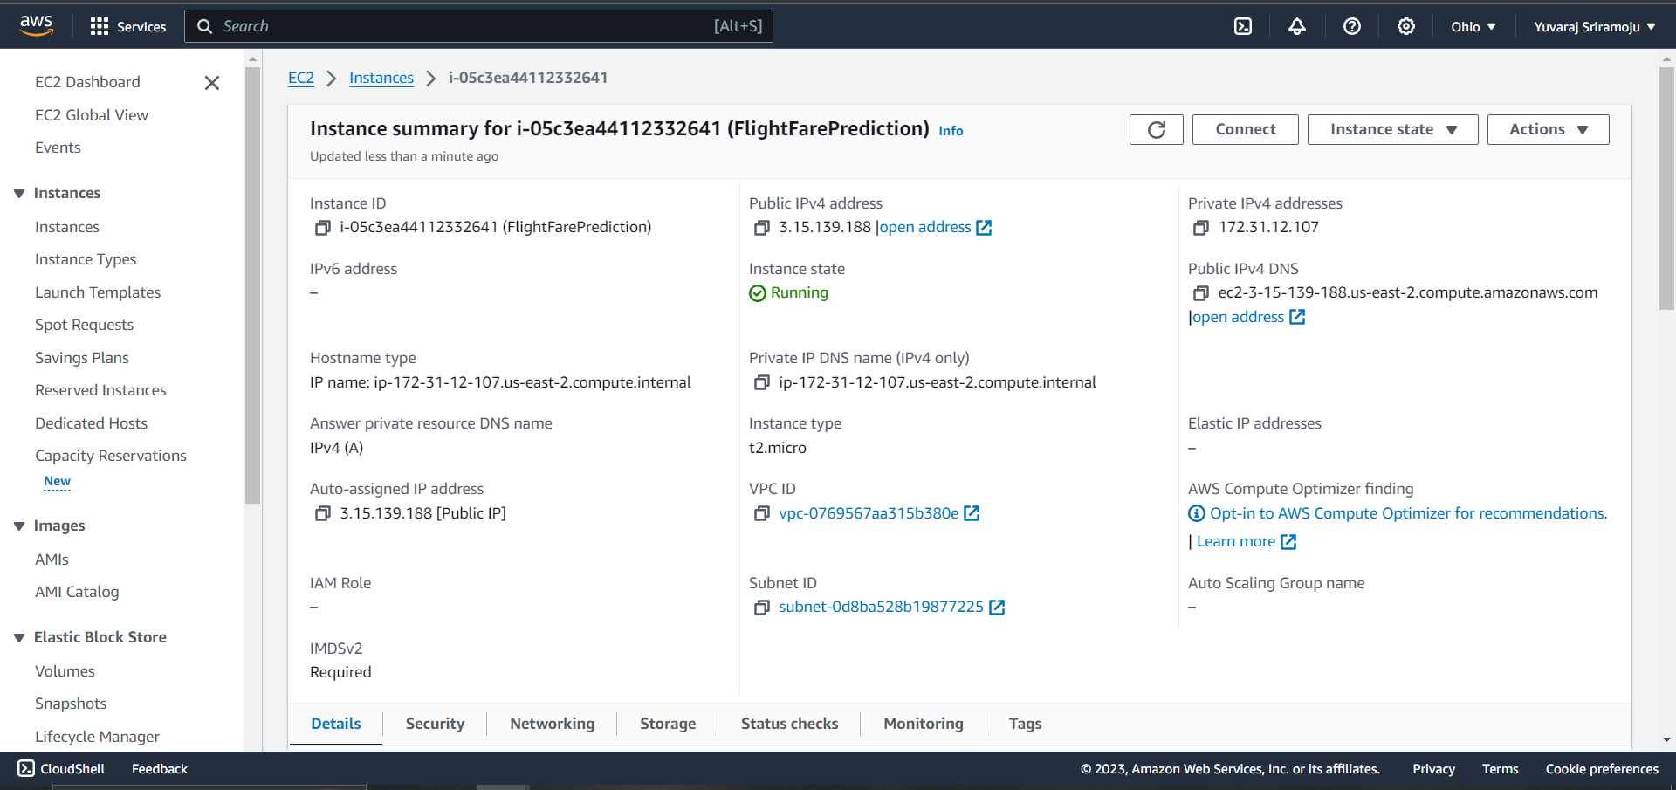
Deployment In AWS

Slide 14
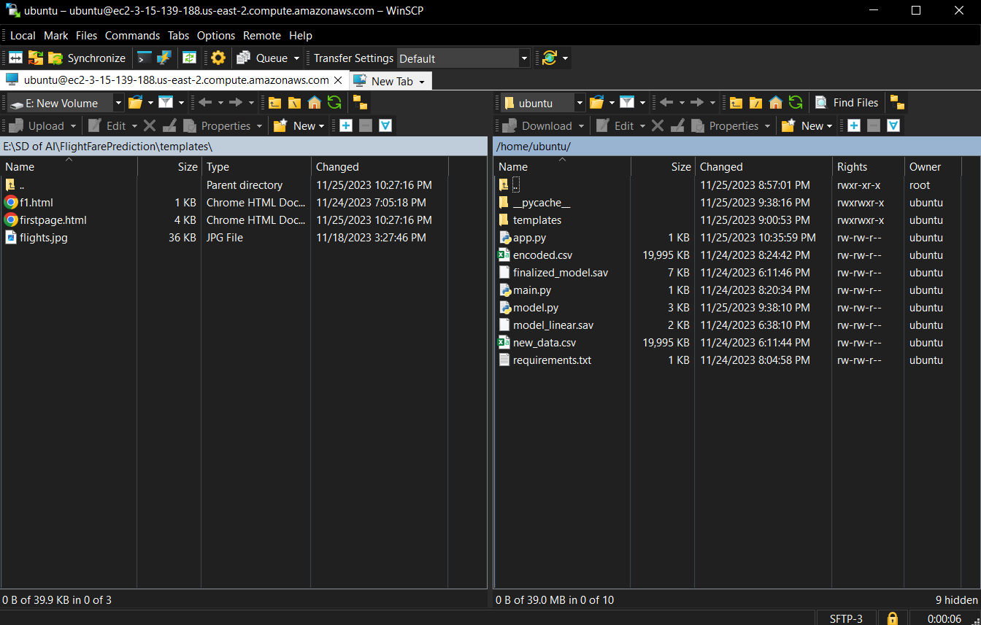
Deployment In AWS
We created a workspace for Amazon AWS using WinSCP.
We transferred all the required files for the project development such as, app.py, model.py, modeks and templates.
WINSCP

Slide 15
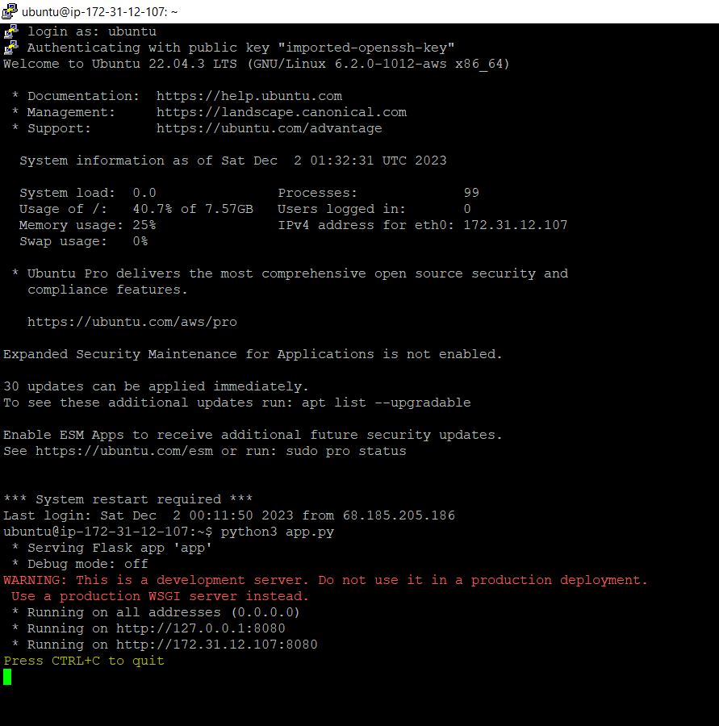
Deployment In AWS
PuTTy
We deployed our model in Amazon AWS using PuTTy PPK.
We saved the instance as flightfarepred and loaded it from PuTTy and logged in.
To keep application running in AWS, the console should be running in the background as backend.
We can now deploy the model by using python3 app.py command in console.
The Project’s publicly accessible link is : http://ec2-3-15-139-188.us-east-2.compute.amazonaws.com:8080/

Slide 16
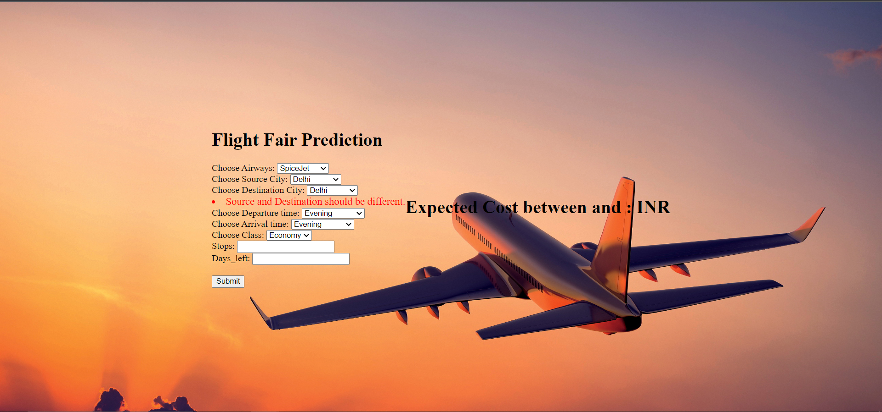
Project Execution
Step 1 : Copy and Paste the link in preferred web browser
http://ec2-3-15-139-188.us-east-2.compute.amazonaws.com:8080/
The Below webpage will be displayed

Slide 17

Project Execution
Step 2:Now the User inputs the values and click on Submit button

Slide 18
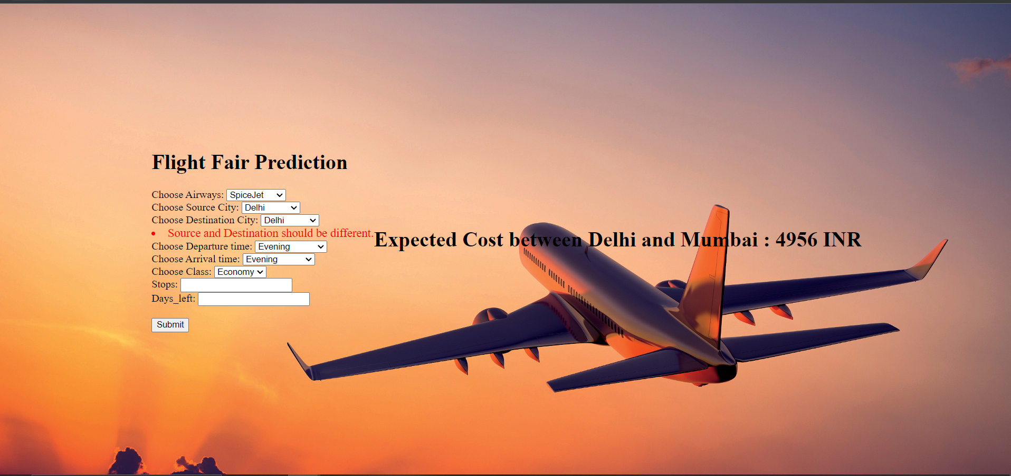
Prediction 1

Slide 19
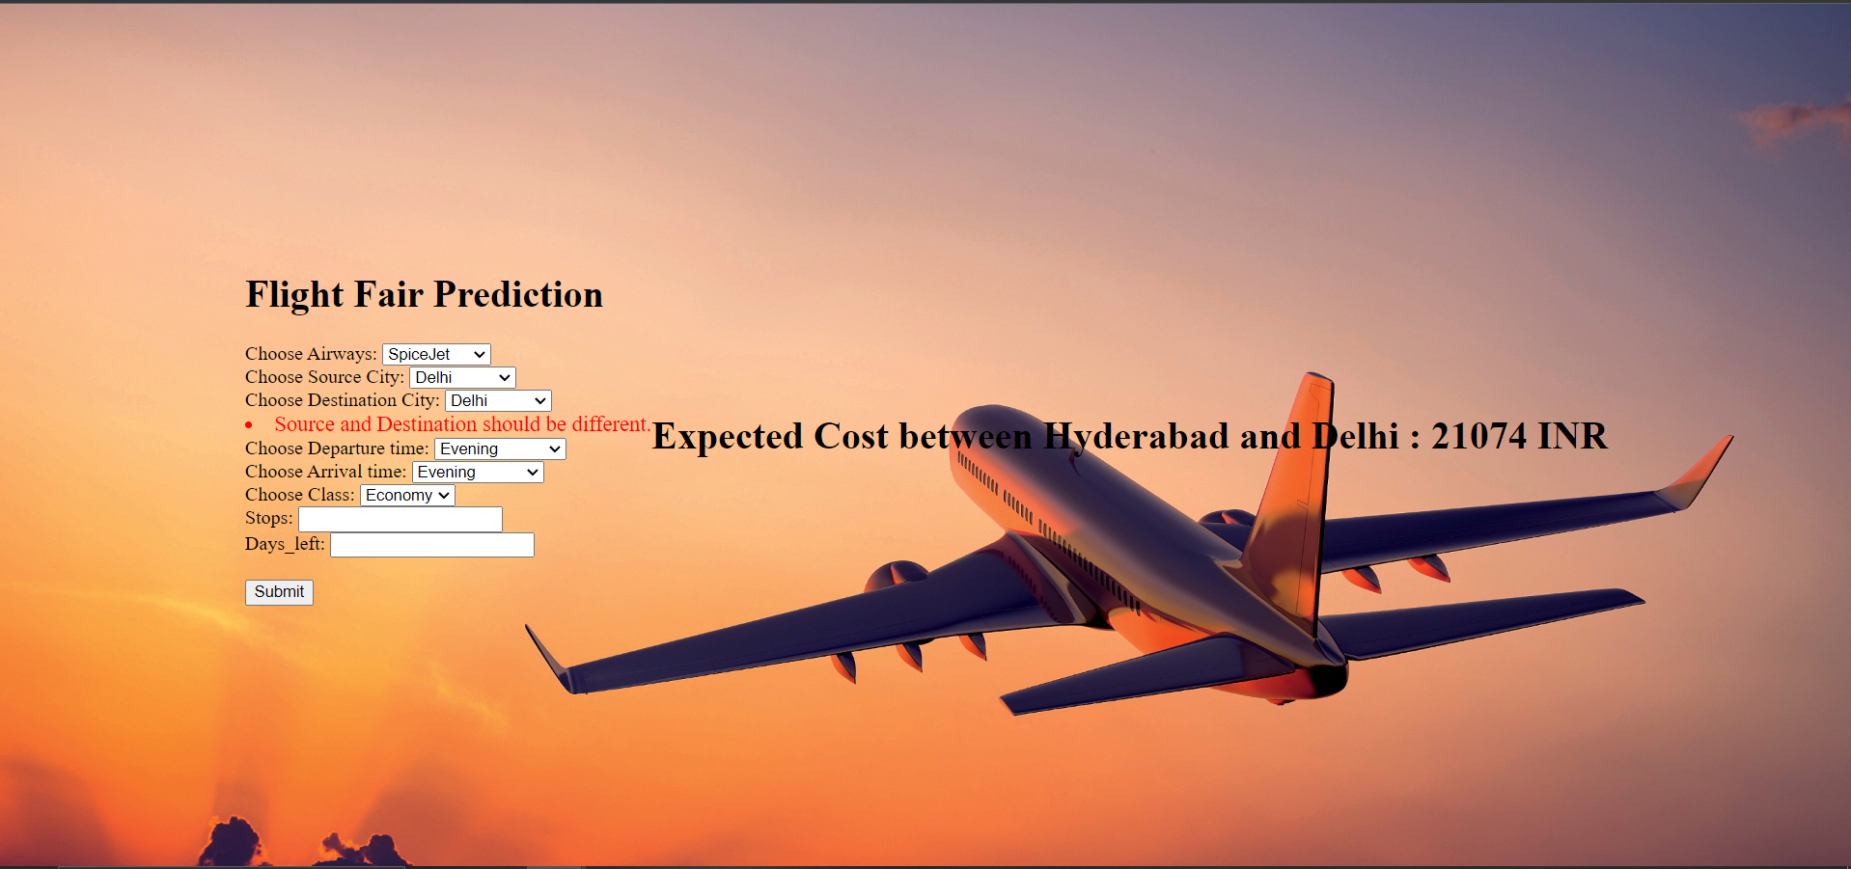
Prediction 2

Slide 20
Live Demonstration Link
https://drive.google.com/file/d/1H69wEADtHXoBRENGSqHf_beb8XUPcUdy/view?usp=sharing

Slide 21
Github Link
https://github.com/AchyuthReddy22/SD_Fligt_Fair_Prediction

Slide 22
Conclusion
Explored Machine Learning Algorithms: We explored various Machine Learning Regression Algorithms like Linear Regression, KNN Regressor, SVR, Decision Trees, Random Forest Regressor, XGBoost to predict the fare of the flight.
Model Selection: Consequently, we made the strategic decision to finalize Decision Tree as our primary model for prediction ensuring the highest level of accuracy and robustness for our system.
Future Scope: This application can be further extended it’s functionality where it can also be used to predict the prices of International Flights also.

Slide 23


Thank u

